Slide 1


UCF NEWBIE
Mobile Application Interface
Group 6
Jorge Bensus, Robert Stephens, Amjad Sheikh, Ulises Santos
CAP 4104

Slide 2

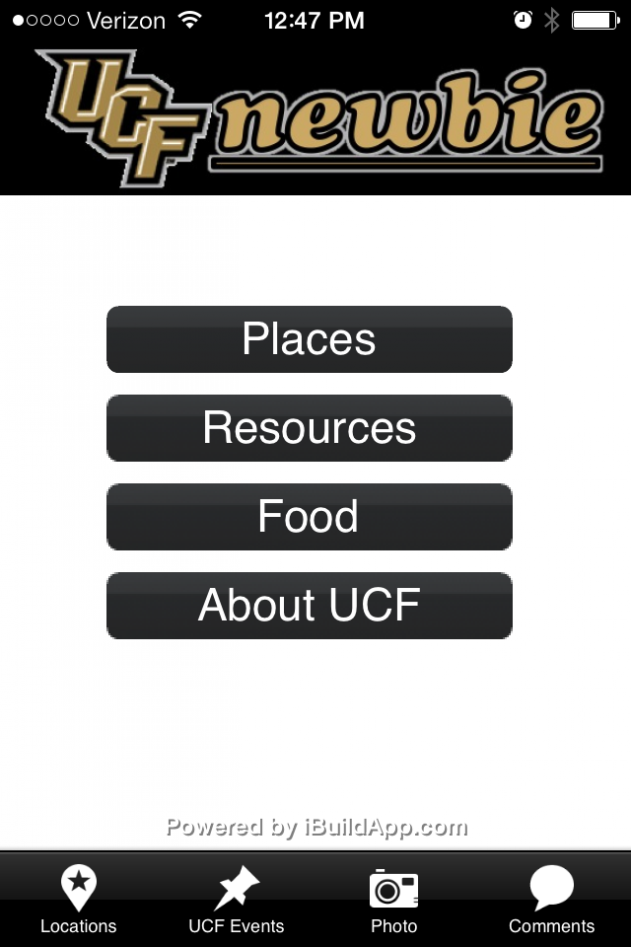
Introduction
Mobil Application that provides:
Basic information about the UCF-Orlando Campus.
On-Campus Navigation and Directions, mainly for Freshman Students.

Slide 3
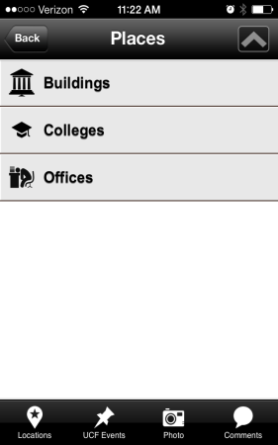
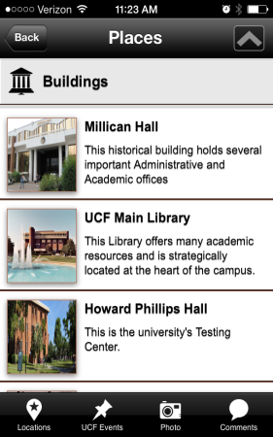
UCF NEWBIE Informational Features
A List Menu style to access the categories and sub-categories.

Slide 4
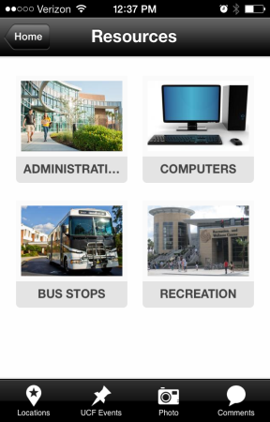
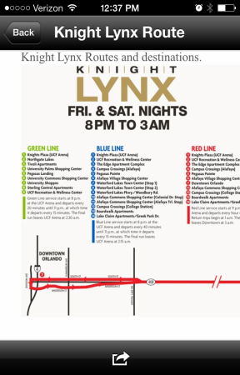
UCF NEWBIE Informational Features
An Icon Menu style to access items grouped into categories.

Slide 5
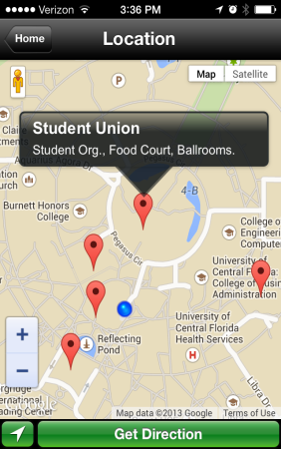
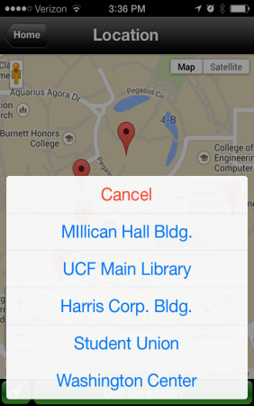
UCF NEWBIE Navigation Features
Navigation features
preloaded on the
Google Maps Mobile Widget.

Slide 6
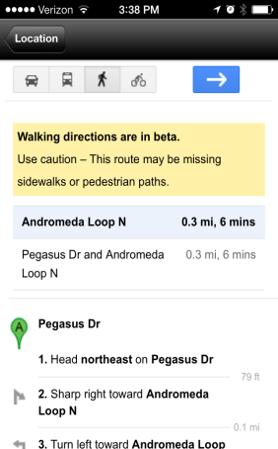
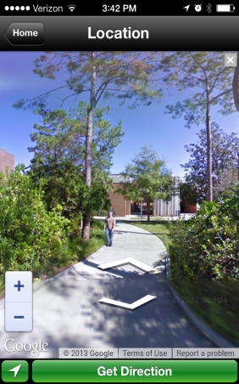
UCF NEWBIE Navigation Features
Turn by turn directions available in different modes, including pedestrian.
Virtual tour of the campus with 360° view.

Slide 7
Usability Test
The Goal
To see if the UCF NEWBIE application features an easy to use interface for freshman students.
To collect feedback from participants and make improvements on the interface.

Slide 8

Experiment
Population
Randomly selected.
Freshmen students between
the ages of 18 and 25.
Non-Technology or engineering majors.

Slide 9

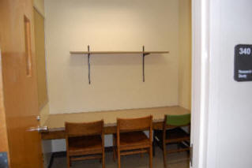

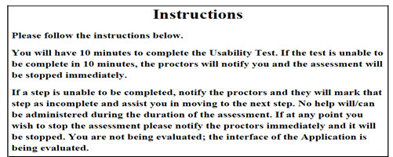
Experiment

Slide 10
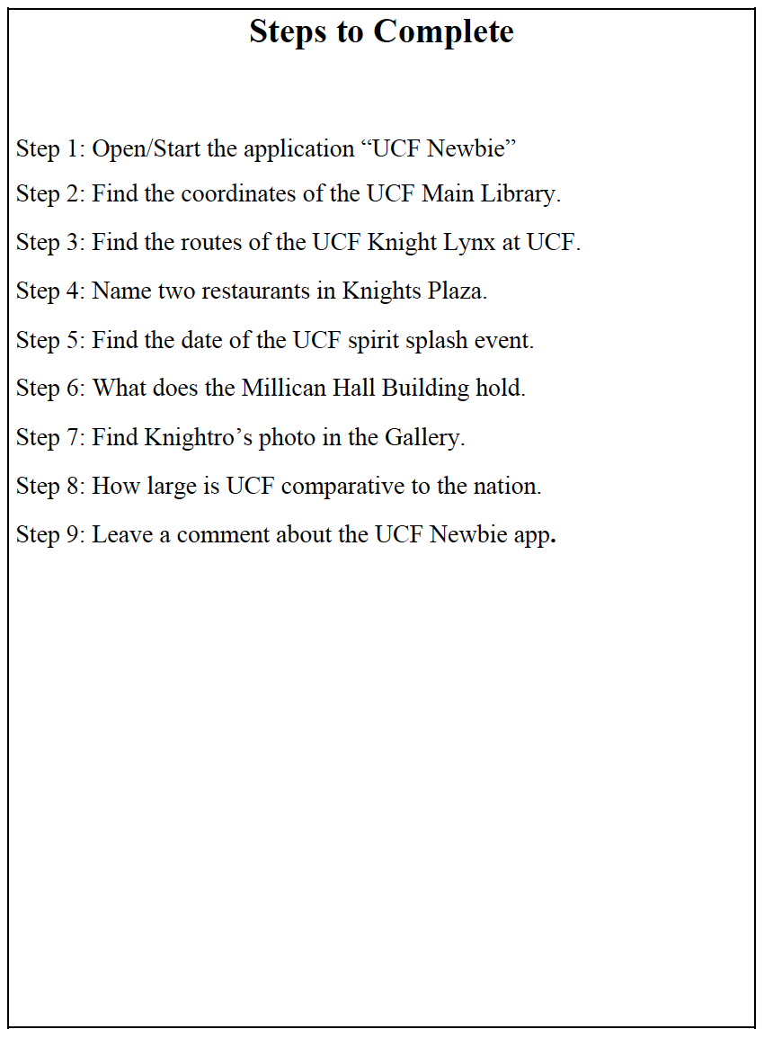
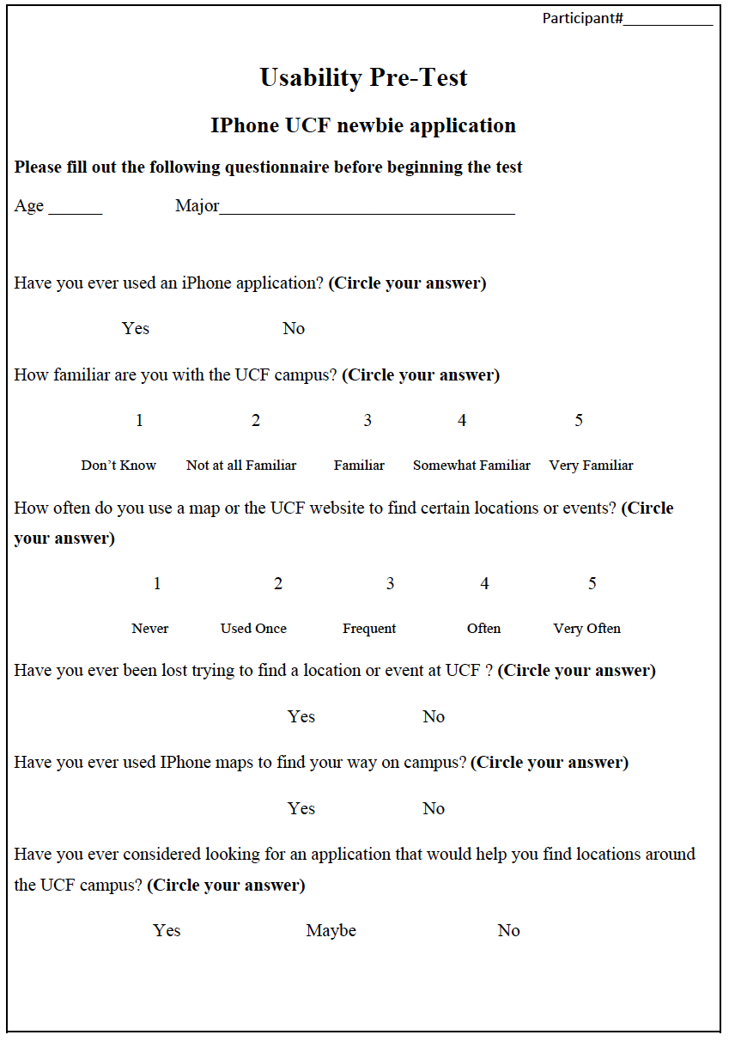
Tasks and Pre-Test

Slide 11



Data Gathering

Slide 12
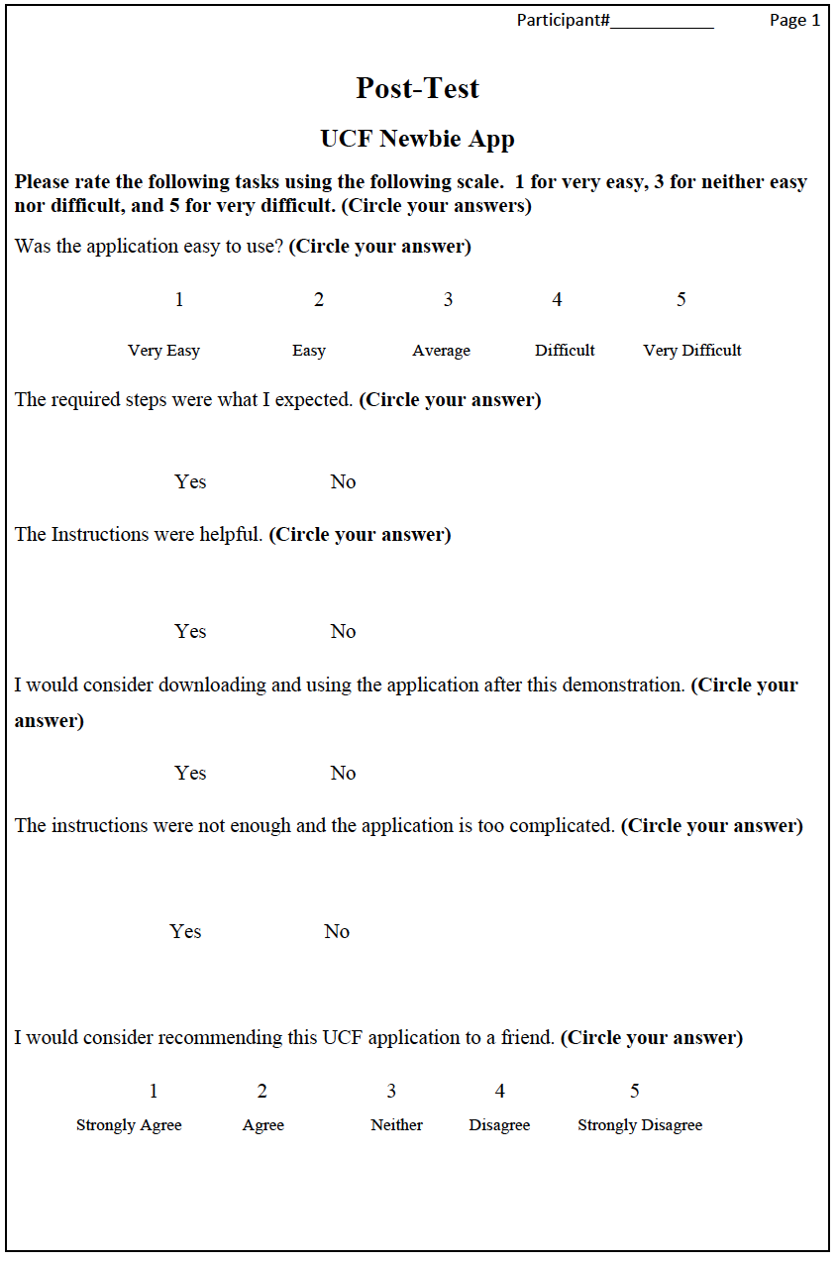
Post-Test

Slide 13
Results
Times
Tasks | Participant 1 | Participant 2 | Participant 3 | Participant 4 | Participant 5 | Participant 6 | Participant 7
Step 1: Open/Start the application “UCF Newbie” | 4.8 | 6.6 | 7.8 | 9.5 | 9.6 | 3.7 | 4.8
Step 2: Find the coordinates of the UCF Library. | 48.5 | 42.6 | 52.9 | 1.22 | 42.8 | 21.8 | 1.2
Step 3: Find the routes of the UCF Knight Lynx bus. | 2.37 | 1.32 | 20.2 | 12.7 | 22.9 | 16.2 | 12.8
Step 4: Name two restaurants in Knights Plaza. | 20 | 19.8 | 35.8 | 21.4 | 12.8 | 15.3 | 8.2
Step 5: Find the date of the UCF spirit splash event. | 6.8 | 14.9 | 7.8 | 11.6 | 23.4 | 11.6 | 6.8
Step 6: What does the Millican Hall Building hold. | 16.1 | 20.3 | 17 | 20.3 | 10 | 13.1 | 9.3
Step 7: Find Knightro’s photo in the Gallery. | 10.1 | 10.5 | 7.6 | 8.7 | 12.3 | 6.9 | 6.7
Step 8: How large is UCF comparative to the nation. | 35 | 12.1 | 10.2 | 16.5 | 10.5 | 11 | 10
Step 9: Leave a comment about the application. | 5.8 | 8.7 | 8.2 | 10.1 | 7.8 | 6.8 | 8.5
Time/Seconds | 149.47 | 136.82 | 167.5 | 112.02 | 152.1 | 106.4 | 68.3
Time/Minutes | 2.49 | 2.28 | 2.79 | 1.87 | 2.54 | 1.77 | 1.14
Participants were given 5 minutes.
Participant 1 took the longest time at 2.49. Participants 7 took the shortest time at 1.14
All participant were familiar with iPhones.
All participants said that they would consider downloading the application.

Slide 14
Results
Average Time Per Task
None of the participants were given time to explore the application’s features.
The exploration occurred in step 2 of the experiment.

Slide 15
Results
Have you ever got lost on campus

Slide 16
Conclusion
The Original Goal
The Goal was to see if the UCF Newbie has an easy to use interface for freshman students.
Planning
  Design an Interface that can be useful to incoming students unfamiliar with the UCF – Orlando campus.
Resources
  Controlled room in the UCF main library
  Freshman Students

Slide 17
Conclusion
The Usability Test
Conducting the Test
Observing and Gathering Data
Interface Improvement
  2 participants said that the interface was hard to use at first, but after a short time of exploring it they thought it was easy to use.
  Overall, the interface is overall easy to use and useful.

Slide 18
Conclusion
The Results
Overall, the results were positive. All the participants were able to complete each step.
Results show that all participants were
able to use and navigate
through all the required
steps.

Slide 19

The Bottom Line
Students comments
Easy to use.
Helpful.
Recommendations
Make it easier to find some features on the application.
Group’s Conclusion
The feedback gathered from the participants was positive. Most of them stated that the interface was very helpful.

